Slide 1

Mental Health In Technology
By Abeezar Babuji

Slide 2
What are the strongest predictors of poor mental health?
Age
Gender
Regions
Working Conditions
Mental health and physical health
.

Slide 3
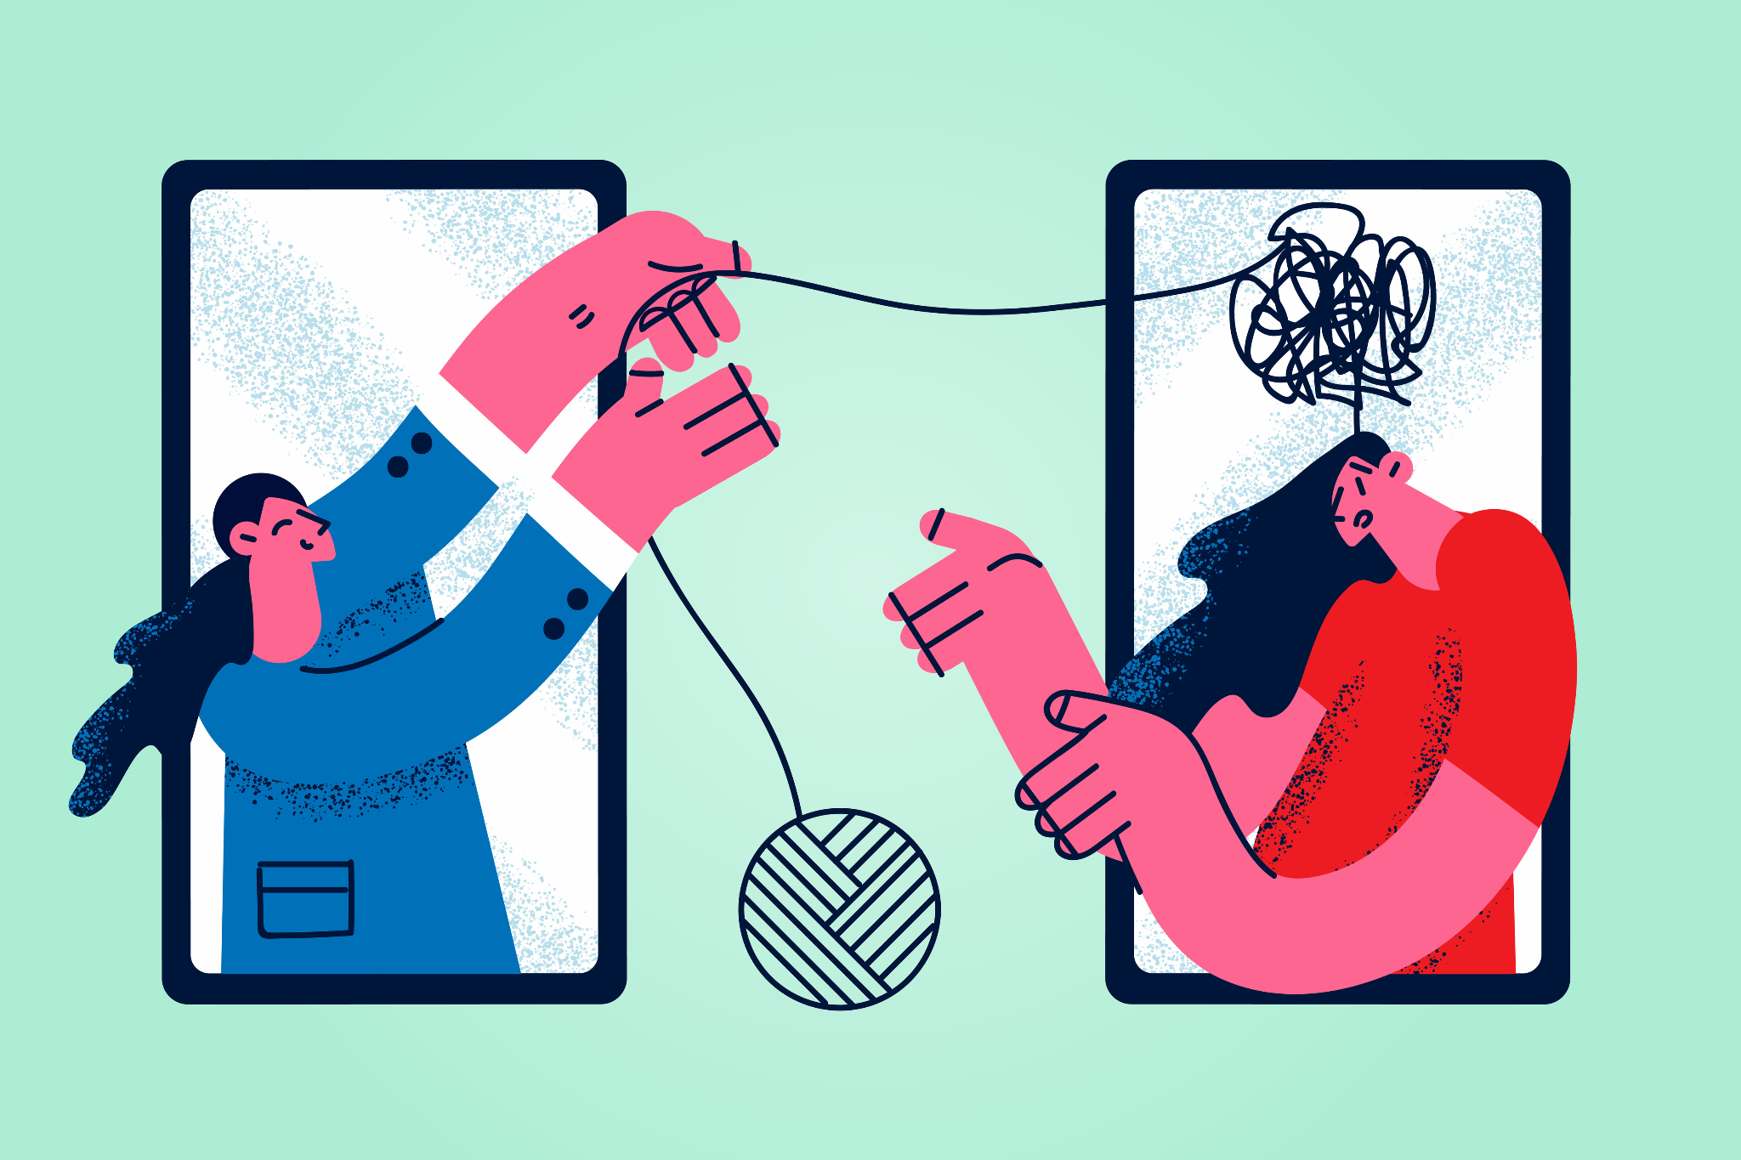
Background/ Importance
Mental Health has been a big topic, and affects everyone
Important to Developers and engineers at risk and companies aiming to support their employees,
According to Forbes, 23% of remote workers struggle with loneliness
Notes:
https://www.forbes.com/councils/forbeshumanresourcescouncil/2023/07/03/how-remote-work-can-impact-employees-mental-health/

Slide 4

Data Cleaning and Preprocessing
Datasource from Kaggle (Mental Health Survey in tech workplace from 2014)
Total of 1259 values and 27 variables
Removed unnecessary columns, such as Timestamp, state, and comments
Standardized Country and Gender values to stay consistent
Fixed age column (people aged from 1 and over 100)
Removed or cleaned NA values
Factored categorical values for model use
Notes:
https://www.kaggle.com/datasets/osmi/mental-health-in-tech-survey

Slide 5
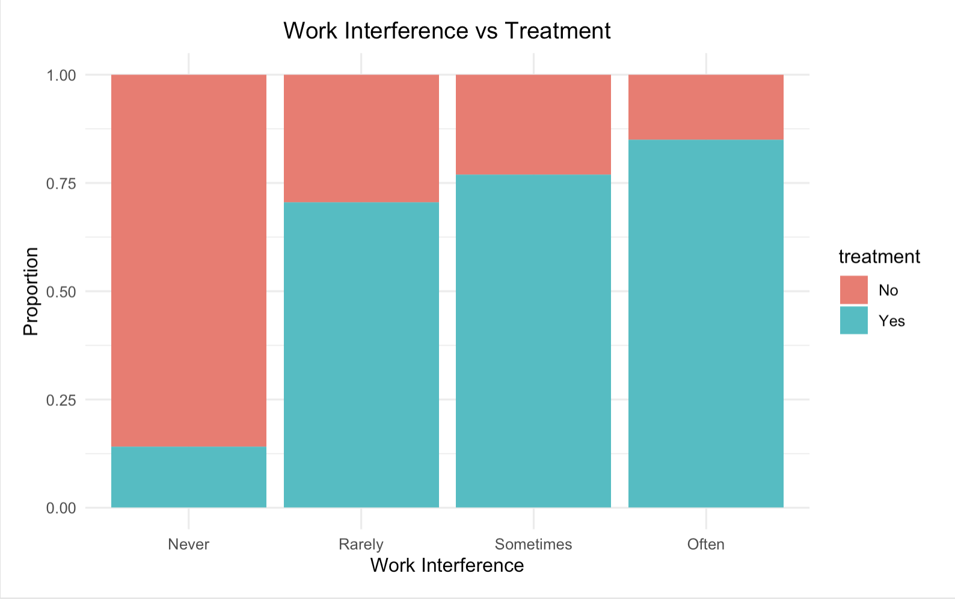
Data Visualization
As work interference rises from Never to Often, the share of employees who seek treatment climbs sharply from around 13 percent to above 75%
The “Sometimes” and “Often” groups together account for over half of all treatment-seekers, highlighting workload strain as a key driver.

Slide 6
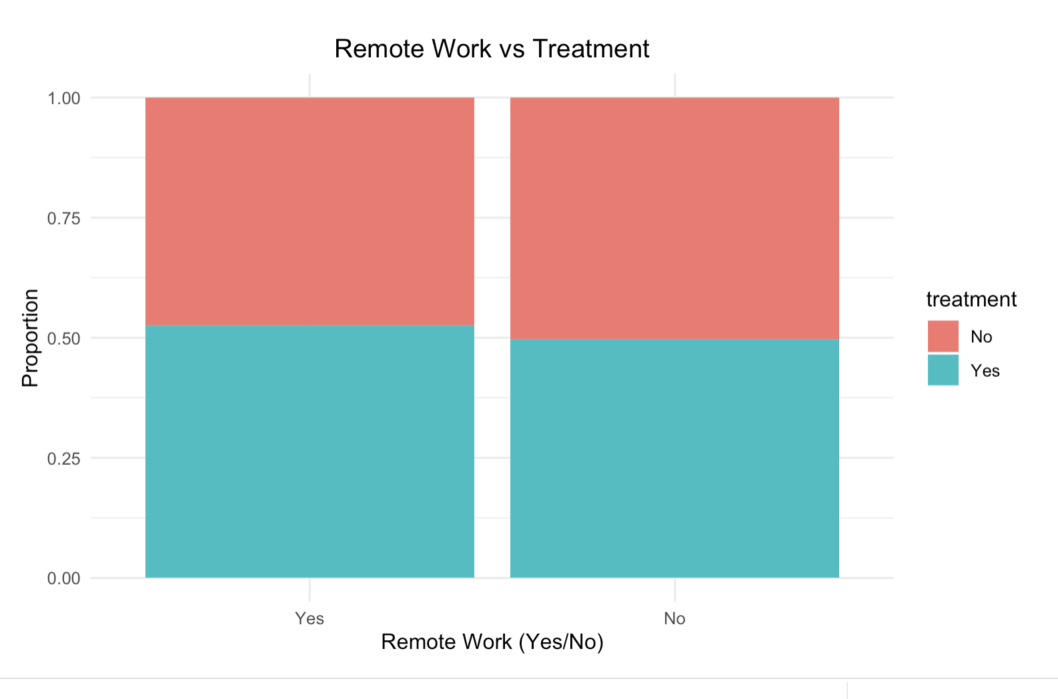
Data Visualization
Remote and Onsite staff show nearly identical rates showing location by itself isn’t the decisive factor always.
This also indicates that support should reach both groups of people instead of just remote workers to achieve better results.

Slide 7
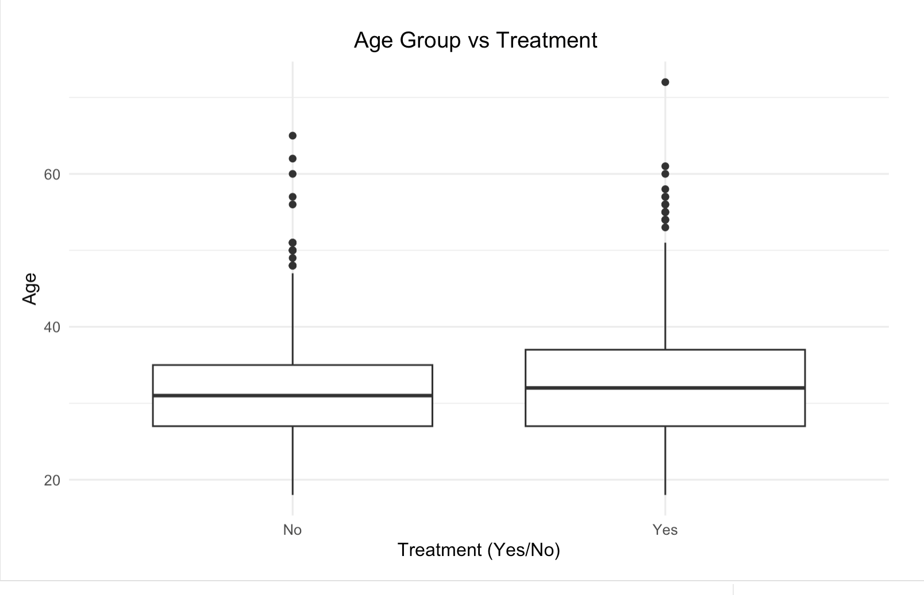
Data Visualization
Median age of those who seek treatment is a few years higher than non-seekers (mid 30s vs early 30s)
Age spread is on the wider side but most outliers cluster in the above 60 group amongst those that are actively seeking treatment
Younger employees are underutilizing treatment/services, so any awareness campaigns can be more effective if younger people are especially targeted.

Slide 8
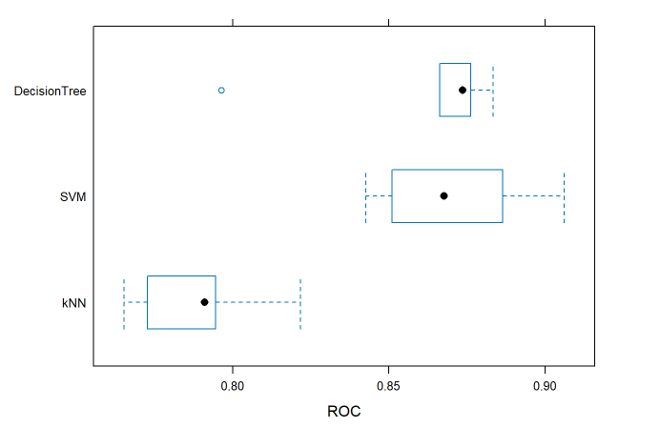
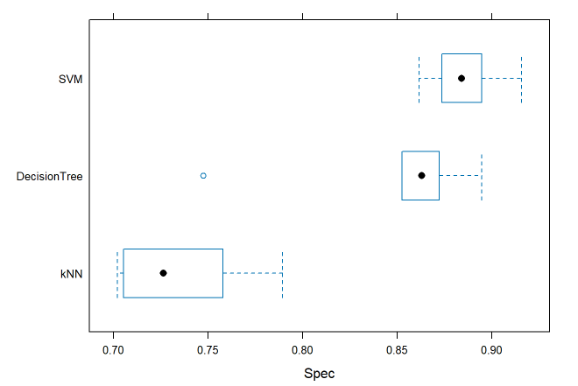
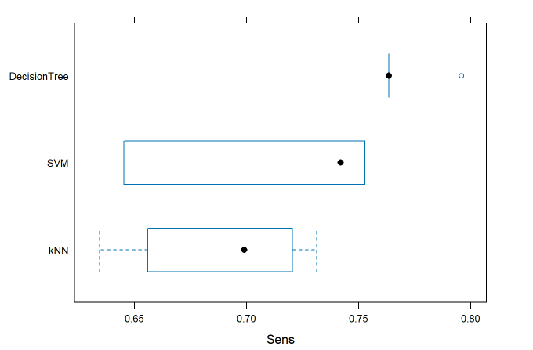
Cross Validation Model Performance
Notes:
https://www.kaggle.com/datasets/osmi/mental-health-in-tech-survey

Slide 9
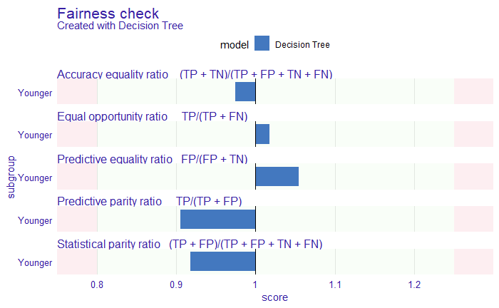
Fairness and Bias Evaluation
Decision Tree:
Total Loss Score: 0.27 (rounded)
Scored the best out of the three Models
Passed 5/5 Fairness Metrics
Most favorable model for Clinical use

Slide 10
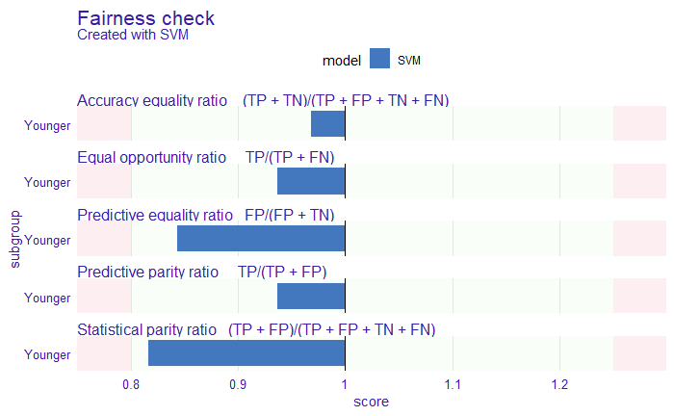
Fairness and Bias Evaluation
SVM:
Total Loss Score: 0.50 (rounded)
Passed 5/5 Fairness Metrics, but very close to not passing

Slide 11
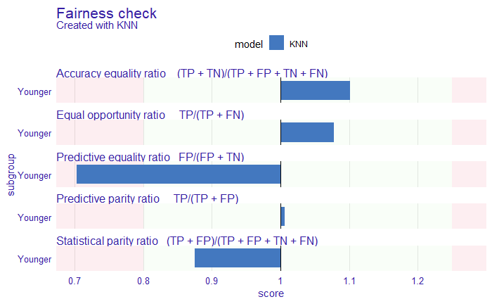
Fairness and Bias Evaluation
KNN:
Total Loss Score: 0.61 (rounded)
Passed 4/5 Fairness Metrics
Least favorable model for Clinical use

Slide 12
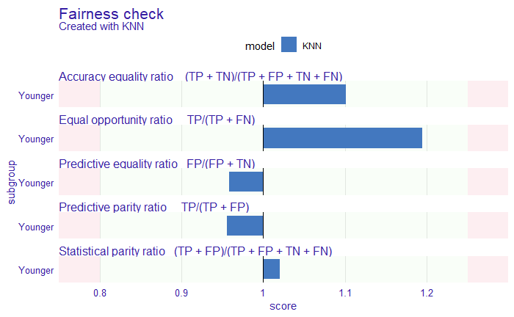
Bias Mitigation
Before Mitigating Bias
KNN Before:
Total Loss Score: 0.61 (rounded)
Passed 4/5 Fairness Metrics
Least favorable model for Clinical use
KNN After:
Total Loss Score: 0.40 (rounded)
Passed 5/5 Fairness Metrics
Utilized Threshold Adjustment
Still not as favorable compared to the Decision Tree
After Mitigating Bias

Slide 13
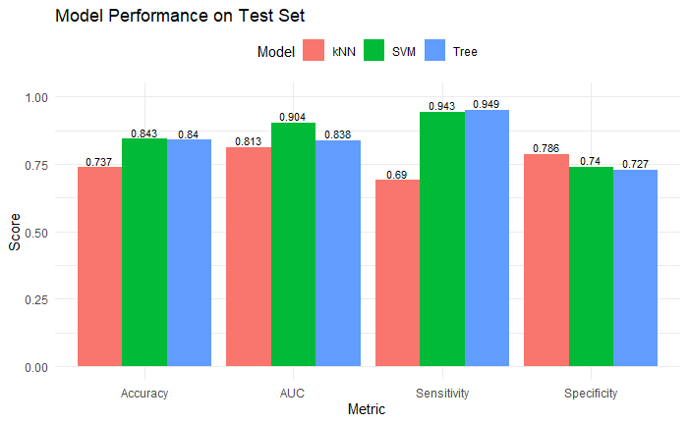
Test Set Evaluation
SVM & Decision Tree Models performed similarly
KNN Performed the Worst Overall
The SVM Model is a more balanced model compared to the Decision Tree
Notes:
https://www.kaggle.com/datasets/osmi/mental-health-in-tech-survey

Slide 14
Metric Selection
Sensitivity
What we considered:
Ethically, it’s better to over-recommend treatment than under-recommend it
False negatives are significantly more harmful to a patient
Untreated mental health issues can escale and have very severe outcomes
Notes:
Ethically,

Slide 15
Recommendation / Referral
Recommendations to Clinicians
Pre-Screening
Treatment for Mental Health
Utilize the Decision Tree Model
Primary goal is to get the most amount of people the treatment they need
Aligns well Ethically
Create a Pipeline to determine if people truly need help
Notes:
https://www.kaggle.com/datasets/osmi/mental-health-in-tech-survey

Slide 16
Thank you for listening!
Questions?
.

